Slide 1

YOUTUBE DATA ANALYSIS
Subham Pal

Slide 2

INTRODUCTION
Our project focuses on analyzing EdTech YouTube channels to determine which ones have the potential to be the best.
We use web scraping to collect data on metrics such as views, subscribers, and engagement rates such as like counts.
Our project utilizes data visualization techniques to provide a clear and concise representation of the data.
The analysis provides a comprehensive overview of the performance of various YouTube channels, enabling users to compare and contrast different channels.
Our goal is to help businesses, marketers, and individuals better understand the YouTube landscape and identify which channels offer the most potential value for their needs.

Slide 3
PROBLEM STATEMENT
Nowadays, YouTube is best platform to get better reachout. Which is the best channel to promote a product in YouTube.

Slide 4




PROPOSED SOLUTION
The proposed solution for the problem at hand involves developing a Python-based web scraping tool that can efficiently collect and analyse data from various EdTech YouTube channels.
The aim is to extract relevant metadata such as video titles, descriptions, tags, likes, dislikes, comments, and other data from multiple channels by utilizing unique channel IDs as keys.
We will develop a web scraping tool to collect data from edtech channels and create visualizations like charts, graphs, and heat maps to provide a clear representation of the data.
By comparing and contrasting different edtech channels, we will provide insights into which channels have the most potential value for students, educators, and educational institutions
Downloading the contents
Extracting the data
Storing the data
Analyzing the data

Slide 5

EXPERIMENTAL SETUP AND RESULT ANALYSIS
The code analyzes YouTube channel statistics using the YouTube Data API v3 and pandas packages.
A Google API key with YouTube Data API v3 enabled is required to run the code.
The code fetches statistics for five channels - College Wallah, Apna College, CodeWithHarry, Jenny’s Lectures CS IT and WsCube Tech - using the get_channel_stats function and stores them in a pandas DataFrame.
The statistics fetched include the number of subscribers, total views, and total videos for each channel.
Bar plots created using the seaborn package allow easy comparison of the statistics for different channels and identification of the most popular channels.

Slide 6
Used Modules : Pandas Numpy Googleapi.client Matplotlib Seaborn

Slide 7
RESULT ANALYSIS
The provided code performs data analysis on the YouTube channels of five educational content creators.
It imports the required libraries and sets the API key for accessing the YouTube API. The code defines a function, get_channel_stats, which takes in a list of channel IDs and returns statistics related to each channel. The data is stored in a pandas Data Frame and converted to numeric values. The code also includes a function to obtain the video IDs for a given playlist, which can be useful for further analysis.
Visualizing data with matplotlib.pyplot and seaborn package.

Slide 8
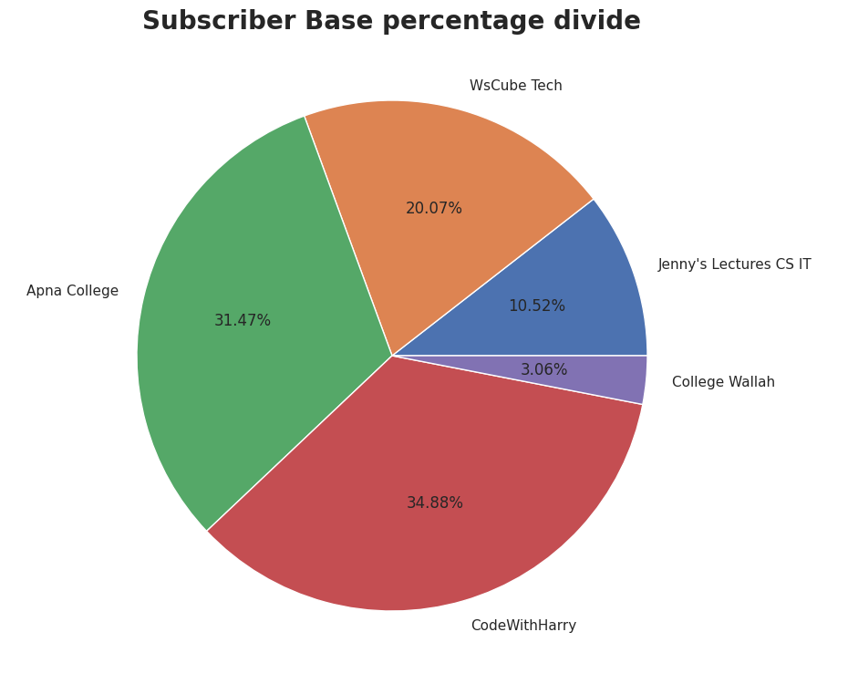
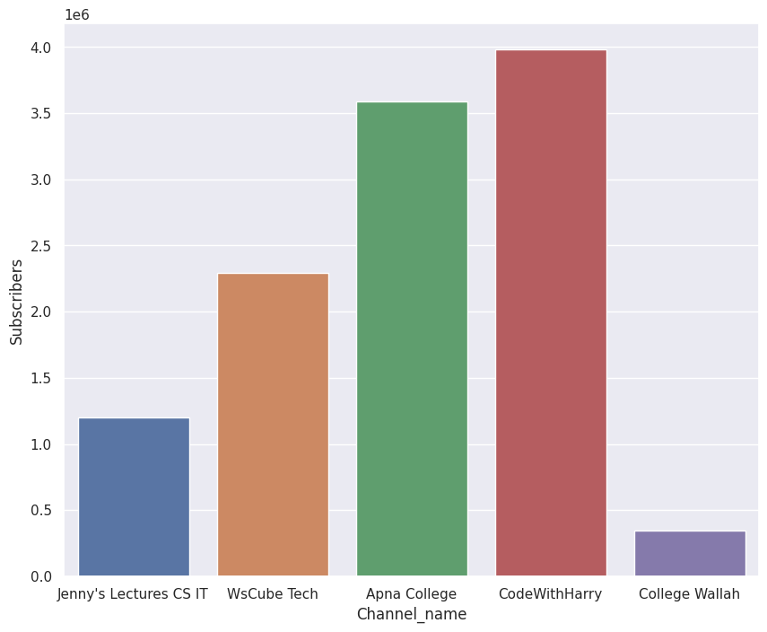
CHANNEL NAME AND SUBSCRIBERS
The given graph is having the details of subscribers of the channels taken as input.
Subscribers vs Channel Name
Channels | Subscriber
CodeWithHarry | 3960000
Apna College | 3570000
WsCube Tech | 2270000
Jenny’s Lecture | 1200000
College Wallah | 347000

Slide 9
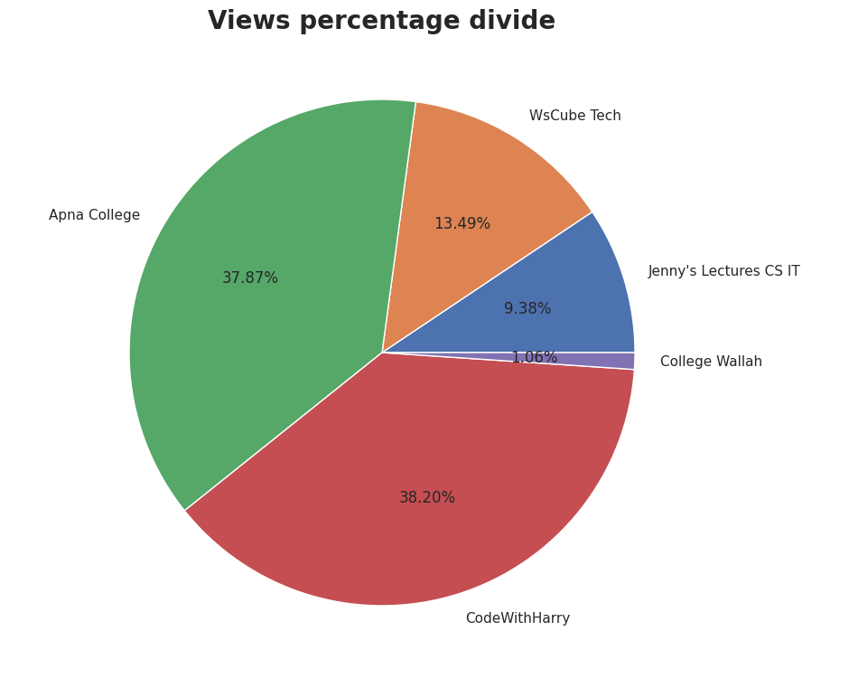
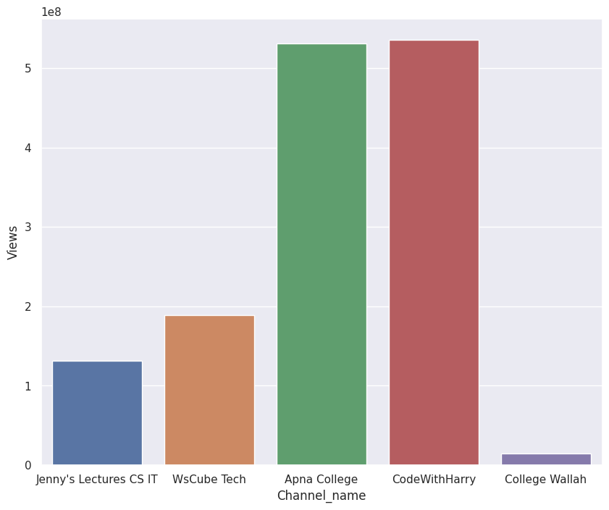
CHANNEL NAME AND VIEWS
The given graph is having the details of views of the channels taken as input. Views vs Channel Name
Channels | Views(M)
CodeWithHarry | 530+
Apna College | 520+
WsCube Tech | 180+
Jenny’s Lecture | 130+
College Wallah | 14+

Slide 10
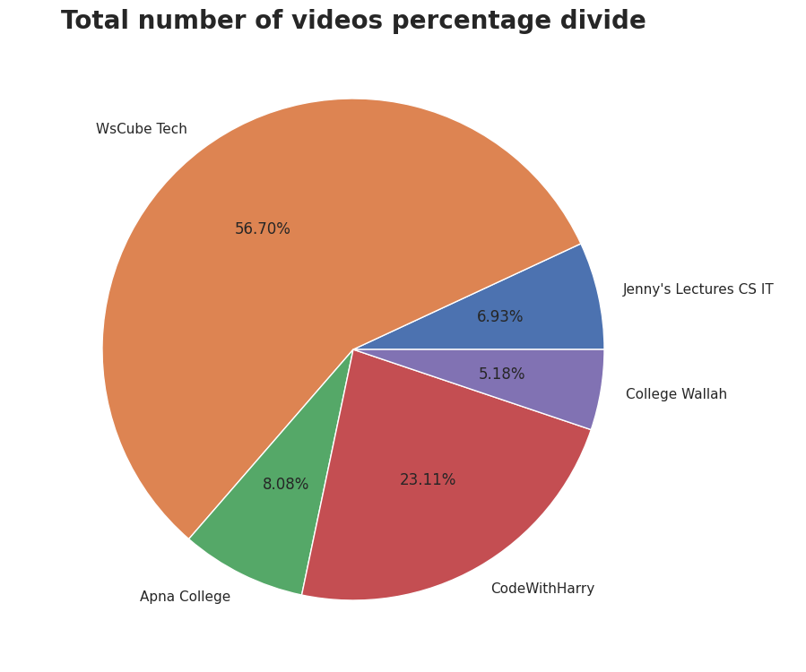
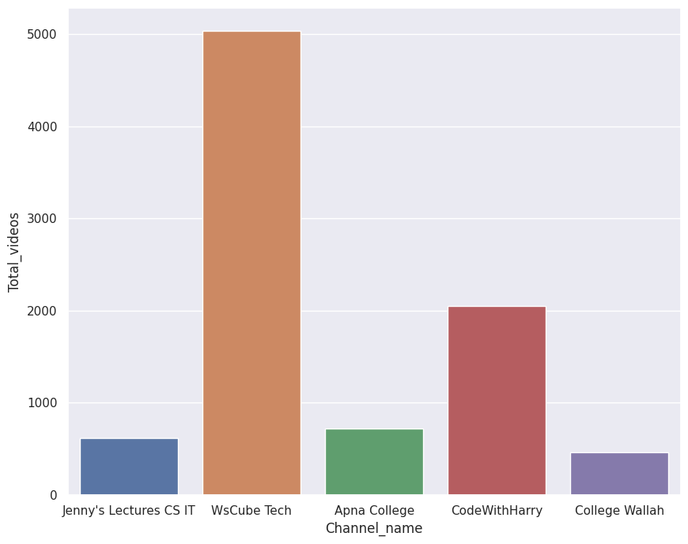
VISUALIZED DATA IN GRAPH FORM
The given graph is having the details of total videos uploaded by the channel. Total Videos vs Channel Name
Channels | No of Videos
CodeWithHarry | 2047
Apna College | 712
WsCube Tech | 5022
Jenny’s Lecture | 612
College Wallah | 446

Slide 11
AVERAGE VIEWS PER VIDEO OF CHANNELS
Channels Names | Avg Views (Views/videos)
CodeWithHarry | 2,60,060
Apna College | 7,40,460
WsCube Tech | 37,300
Jenny’s Lecture | 2,13,740
College Wallah | 32,800
As We can see Apna College has the most Average view count
Lets analyze Apna College College

Slide 12
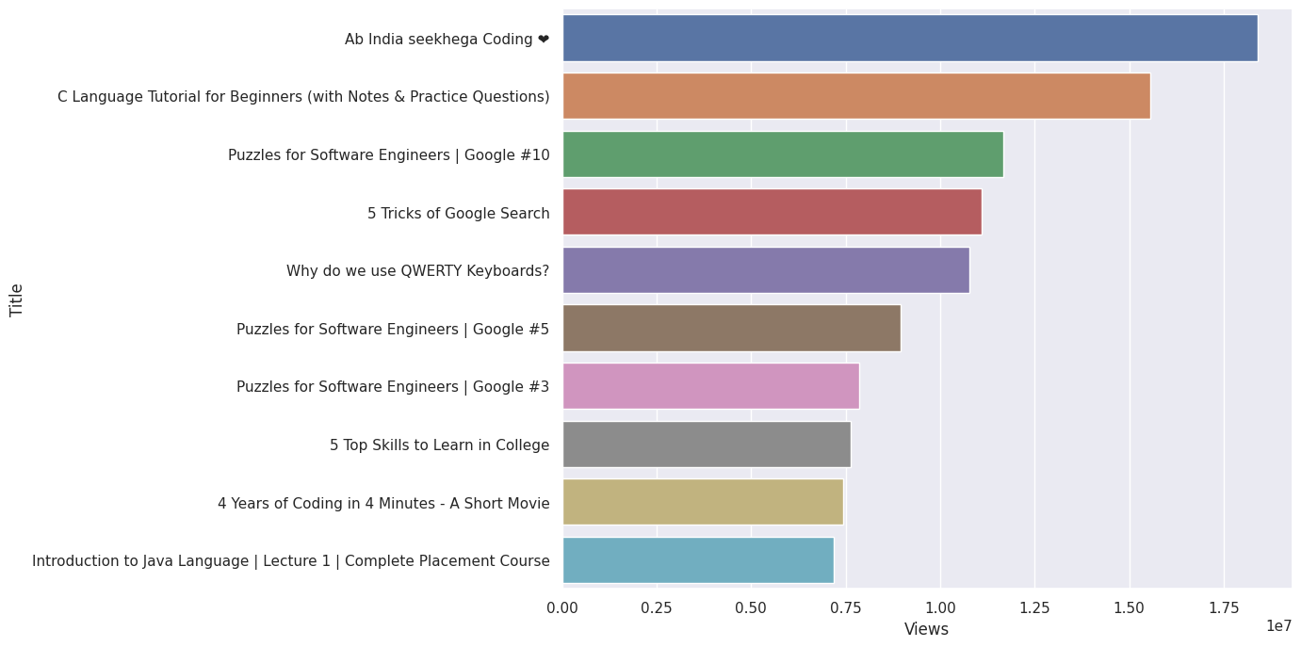
VISUALIZED HORIZONTAL GRAPH OF TOP10 VIDEOS
The given horizontal graph describes Top 10 videos of Apna College Channels

Slide 13
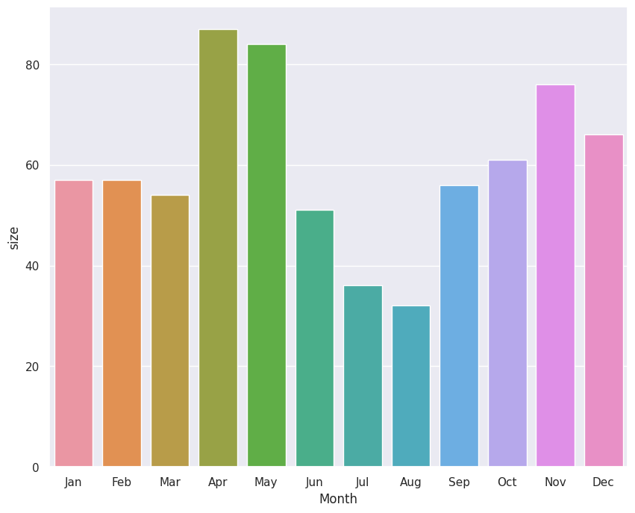
VISUALIZED GRAPH OF MONTHLY UPLOADED VIDEOS
The given graph describes how many videos are uploaded monthly by Apna College Channel

Slide 14
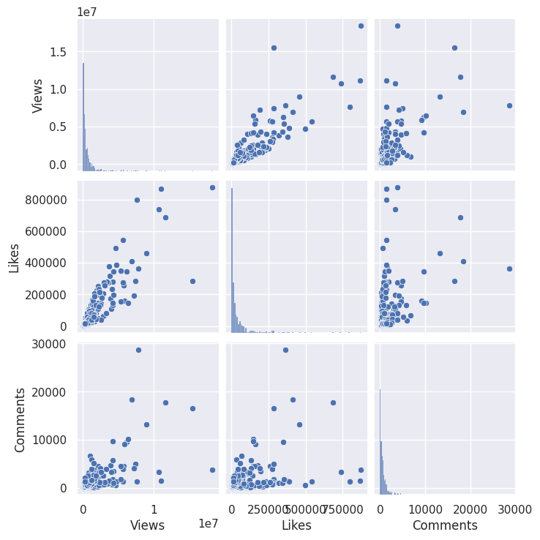
GRAPHICAL REPRESENTATION
z
This graph describes the relation between comments, views, likes achieved by Apna College channel.

Slide 15
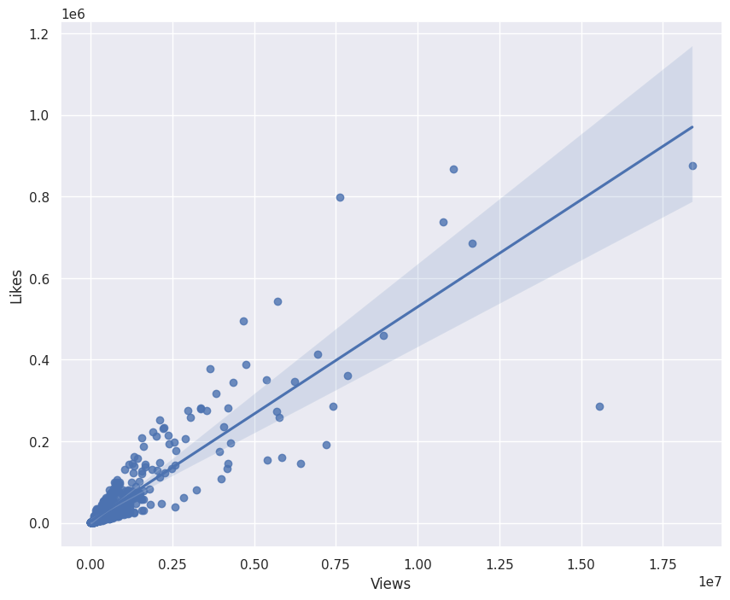
GRAPHICAL REPRESENTATION
z
The given graph describes
the relation between likes and views
of Apna College channel.

Slide 16
CONCLUSION
Channel “CodeWithHarry” is the most viewed and most Subscribed channel uploading 2000+ videos.
“WsCube Tech” is the highest uploading channel with 5000+ videos but very less views that’s mean there is no correlation between number of videos and views
”College Wallah” is comparatively new channel so, it doesn't have more views, but Growth is positive.
Majority of the videos of channel “CodeWithHarry” receives a very low viewing and its only the cumulative views of all videos which help channel to score the highest views of all.
”Apna College” doesn’t have the most subscriber or the most views but their Average views per videos is very high.

Slide 17
FINAL RESULT
The Best channel to promote educational product is “Apna College”
Average Views/Videos is high so, approximate views we can expect is 7 lakh
Very Low fluctuation in View count

